Slide 1
Data Structure
(Beginner)
Arnob Sarker

Slide 2
Good Sequence 1 atcoder-arc087_a
A sequence is a good sequence if for each element x, the value x occurs exactly x times.
(3,3,3), (4,2,4,1,4,2,4) and () are good sequences
(3,3,3,3) and (2,4,1,4,2) are not.
Find the minimum number of elements needed to be removed to make the sequence good.

Slide 3
Good Sequence 2
…
Find the indices of elements needed to be removed to make the sequence good.

Slide 4
Good Sequence 3
…
Find the indices of elements needed to be removed to make the sequence good.
In lexicographically smallest and largest order

Slide 5
Sliding Window Median cses-1076
You are given an array of n integers. Your task is to calculate the median of each window of k elements, from left to right.
8 3
2 4 3 5 8 1 2 1
3 4 5 5 2 1

Slide 6
Resources
Quick reference
STL basics
GfG
GfG cheat sheet
Heap visualization

Slide 7
Range Sum Query
Given an array and Q queries
On each query you have to find the sum of element in range [l, r]
Range sum [l..r] = sum(r) - sum(l-1)

Slide 8
Range Sum Query with Updates
Given an array and Q operations
On query operation you have to find the sum of element in range [l, r]
On update operation you have to change the value of ith element to k

Slide 9
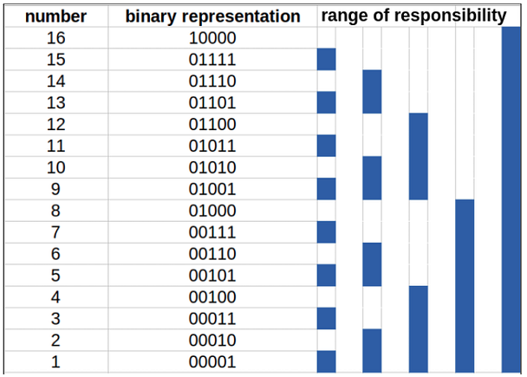
Fenwick Tree (Binary Indexed Tree)
Goal: Maintain an array where we need prefix sums and point updates.
In a Fenwick tree, a certain cell is responsible for other cells as well
The first non-zero bit from right in the binary representation of the index determines the range of responsibility

Slide 10
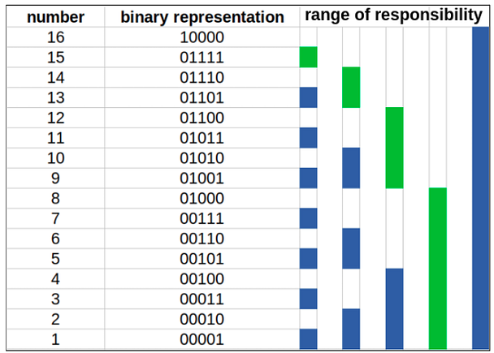
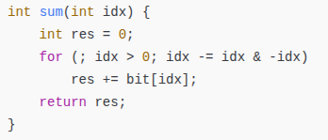
Fenwick Tree (Query)

Slide 11
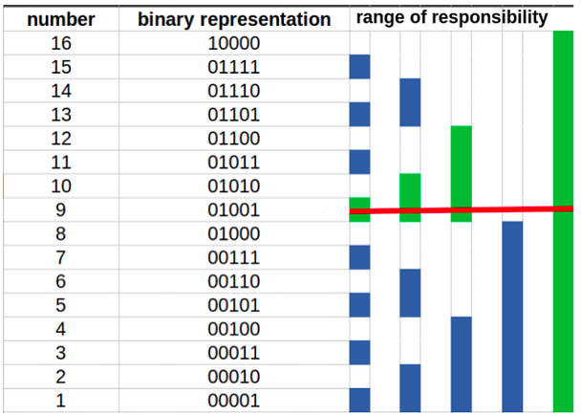
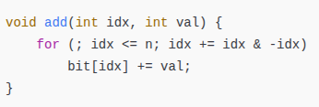
Fenwick Tree (Update)

Slide 12
Count Inversions
Count the number of inversions of an array

Slide 13
Height of Kth person
Given the number of people of each height in the class
At any moment some number of person of some particular height can join or leave the class
On each query you have to tell the height of the Kth people present in the class

Slide 14
Fenwick tree resources
cp-algo

Slide 15
Dynamic Range Minimum Queries cses-1649
update the value at position k to u
what is the minimum value in range [a,b]?

Slide 16
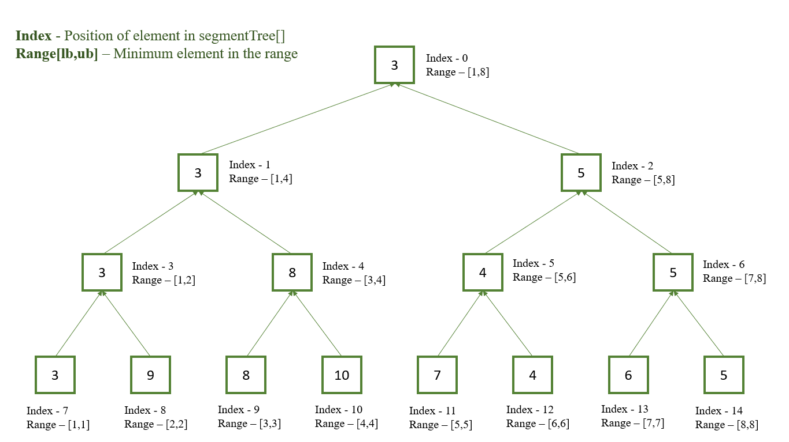
Segment Tree

Slide 17
Hotel Queries cses-1143
There are n hotels on a street. For each hotel you know the number of free rooms.
The groups will come to you one after another, and you know for each group the number of rooms it requires. You always assign a group to the first hotel having enough rooms.
After this, the number of free rooms in the hotel decreases.

Slide 18
Which functions we can use on Segment Tree
Any Associative operation
(x+y)+z = x+(y+z)
Additions, multiplications, bitwise and, or, xor, gcd, etc

Slide 19
Frequent Values uva
Point update
Query : return the most frequent value in range [l, r]

Slide 20
Segment Tree Resources
Cf edu
Cp algo
Learn more:
Lazy propagation
Assignment and addition operation simultaneously

Slide 21
Friend or not
make_friend(a, b): all friends of a and all friends of b becomes friends
is_friend(a, b): are a and b friends?

Slide 22
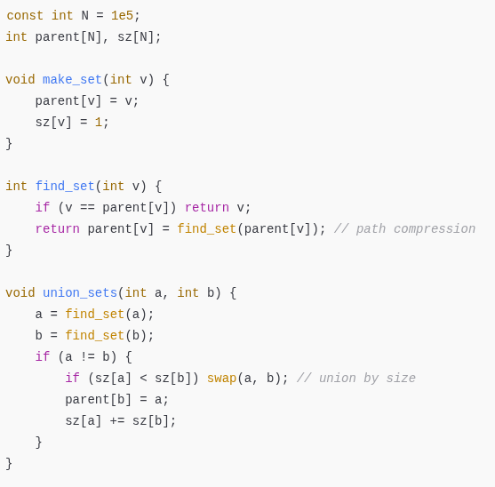
DSU implementations

Slide 23
Road Construction cses-1676
There are n cities and initially no roads between them. However, every day a new road will be constructed, and there will be a total of m roads.
A component is a group of cities where there is a route between any two cities using the roads. After each day, your task is to find the number of components and the size of the largest component.

Slide 24
DSU Resources
Cp algo
Cf edu

